Slide 1
Hypertrophic Cardiomyopathy in Sarcomere Variant Carriers and Non-Carriers Comparing the clinical course of disease
Christoffer Rasmus Vissing
SHaRe investigator meeting
9 May 2023

Slide 2
Hypertrophic cardiomyopathy

Slide 3
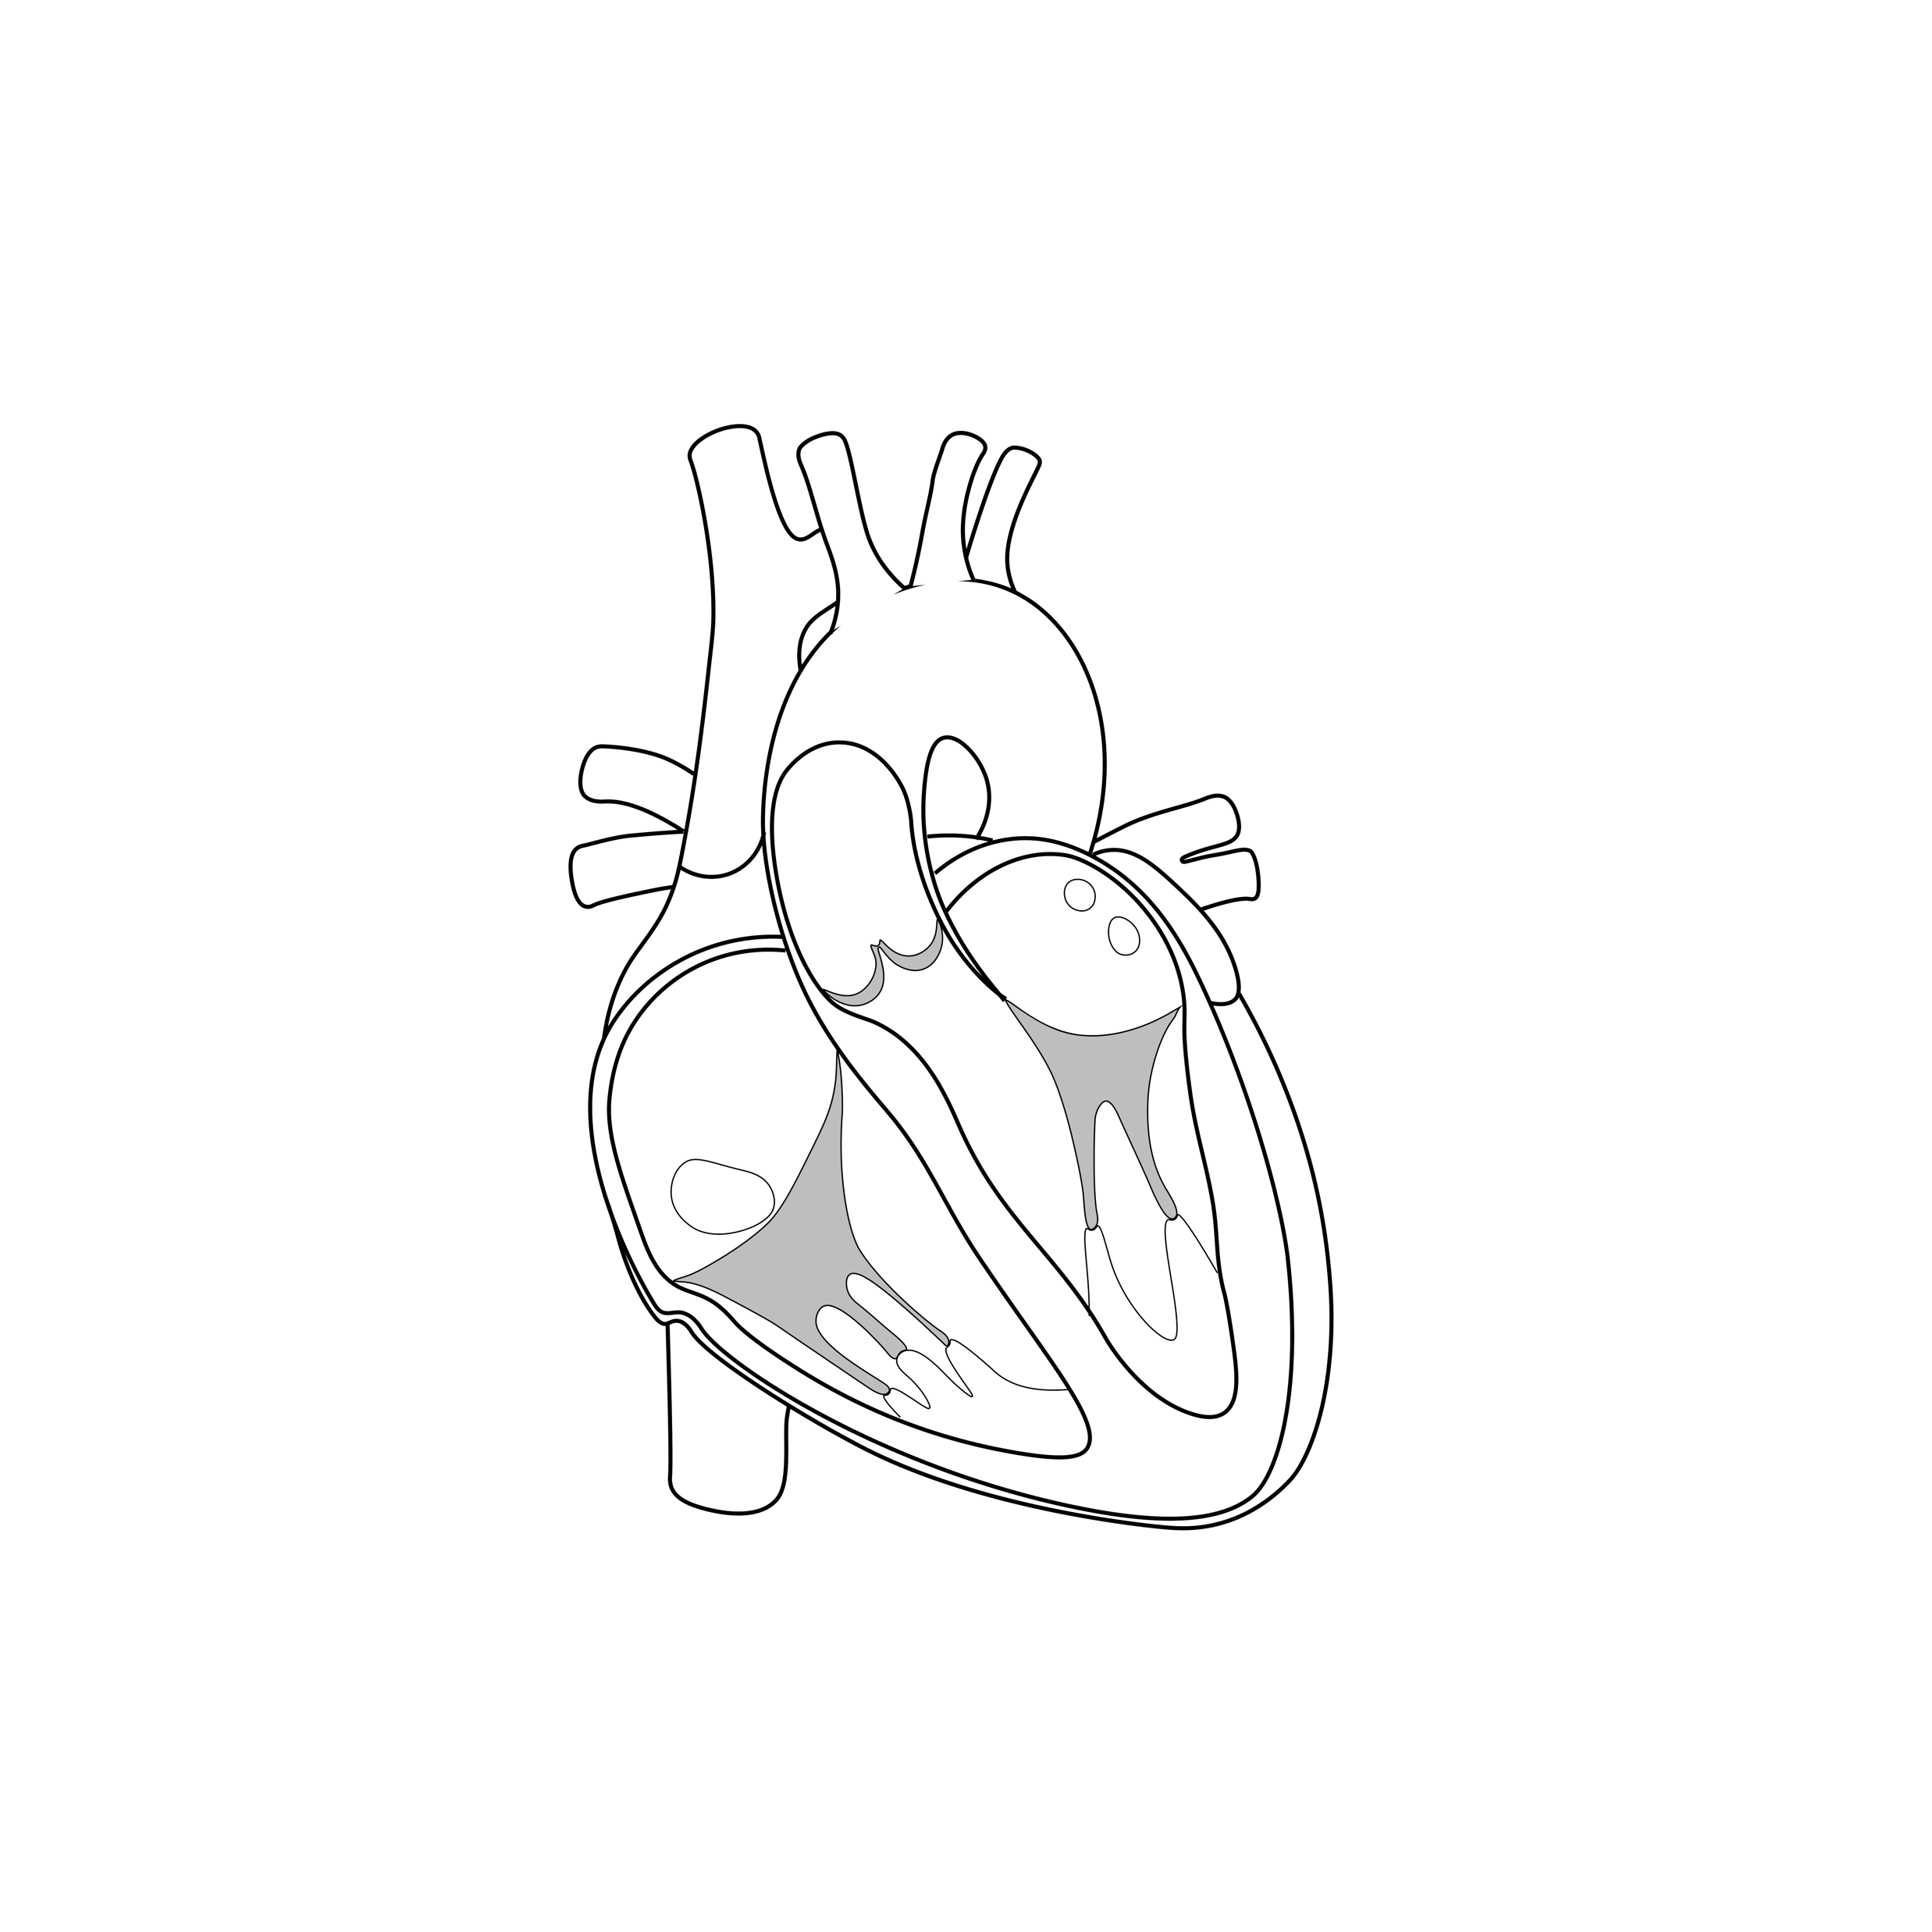
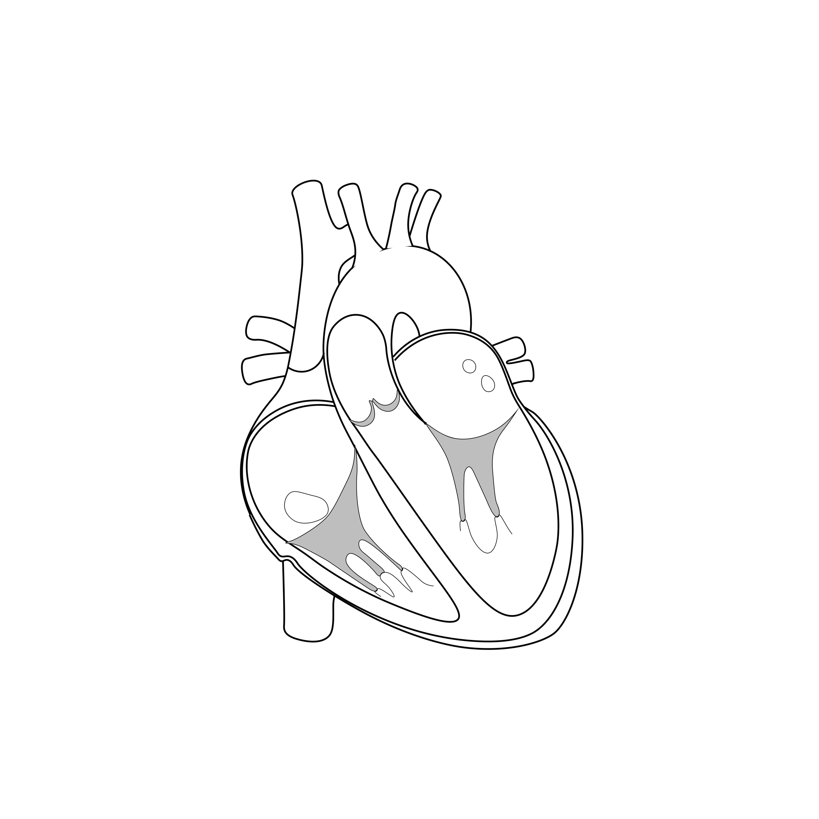
Natural history of disease
Heart failure
Arrhythmias
Normal heart
Presymptomatic
Cardiomyopathy
Premature
Death
LA dilation or other subtle abnormalities
Significant LVH
Genetic and/or
environmental vulnerability
Toxic affection

Slide 4
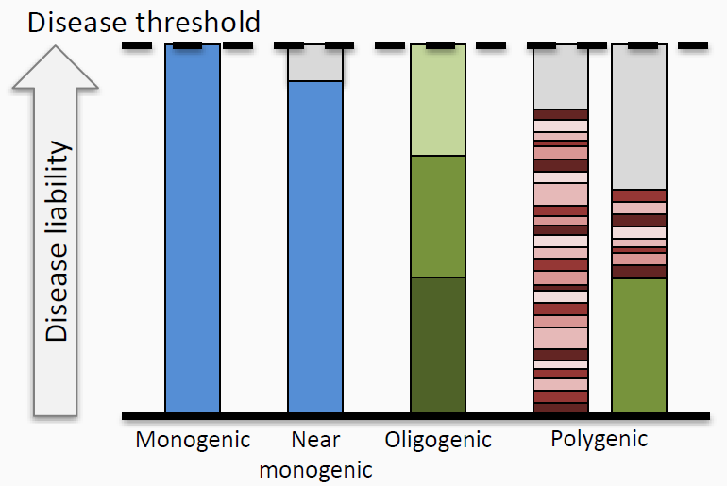
Genetic contribution to disease
Large effect variants (rare)
Intermediate effect variants
Common variants
Environment

Slide 5
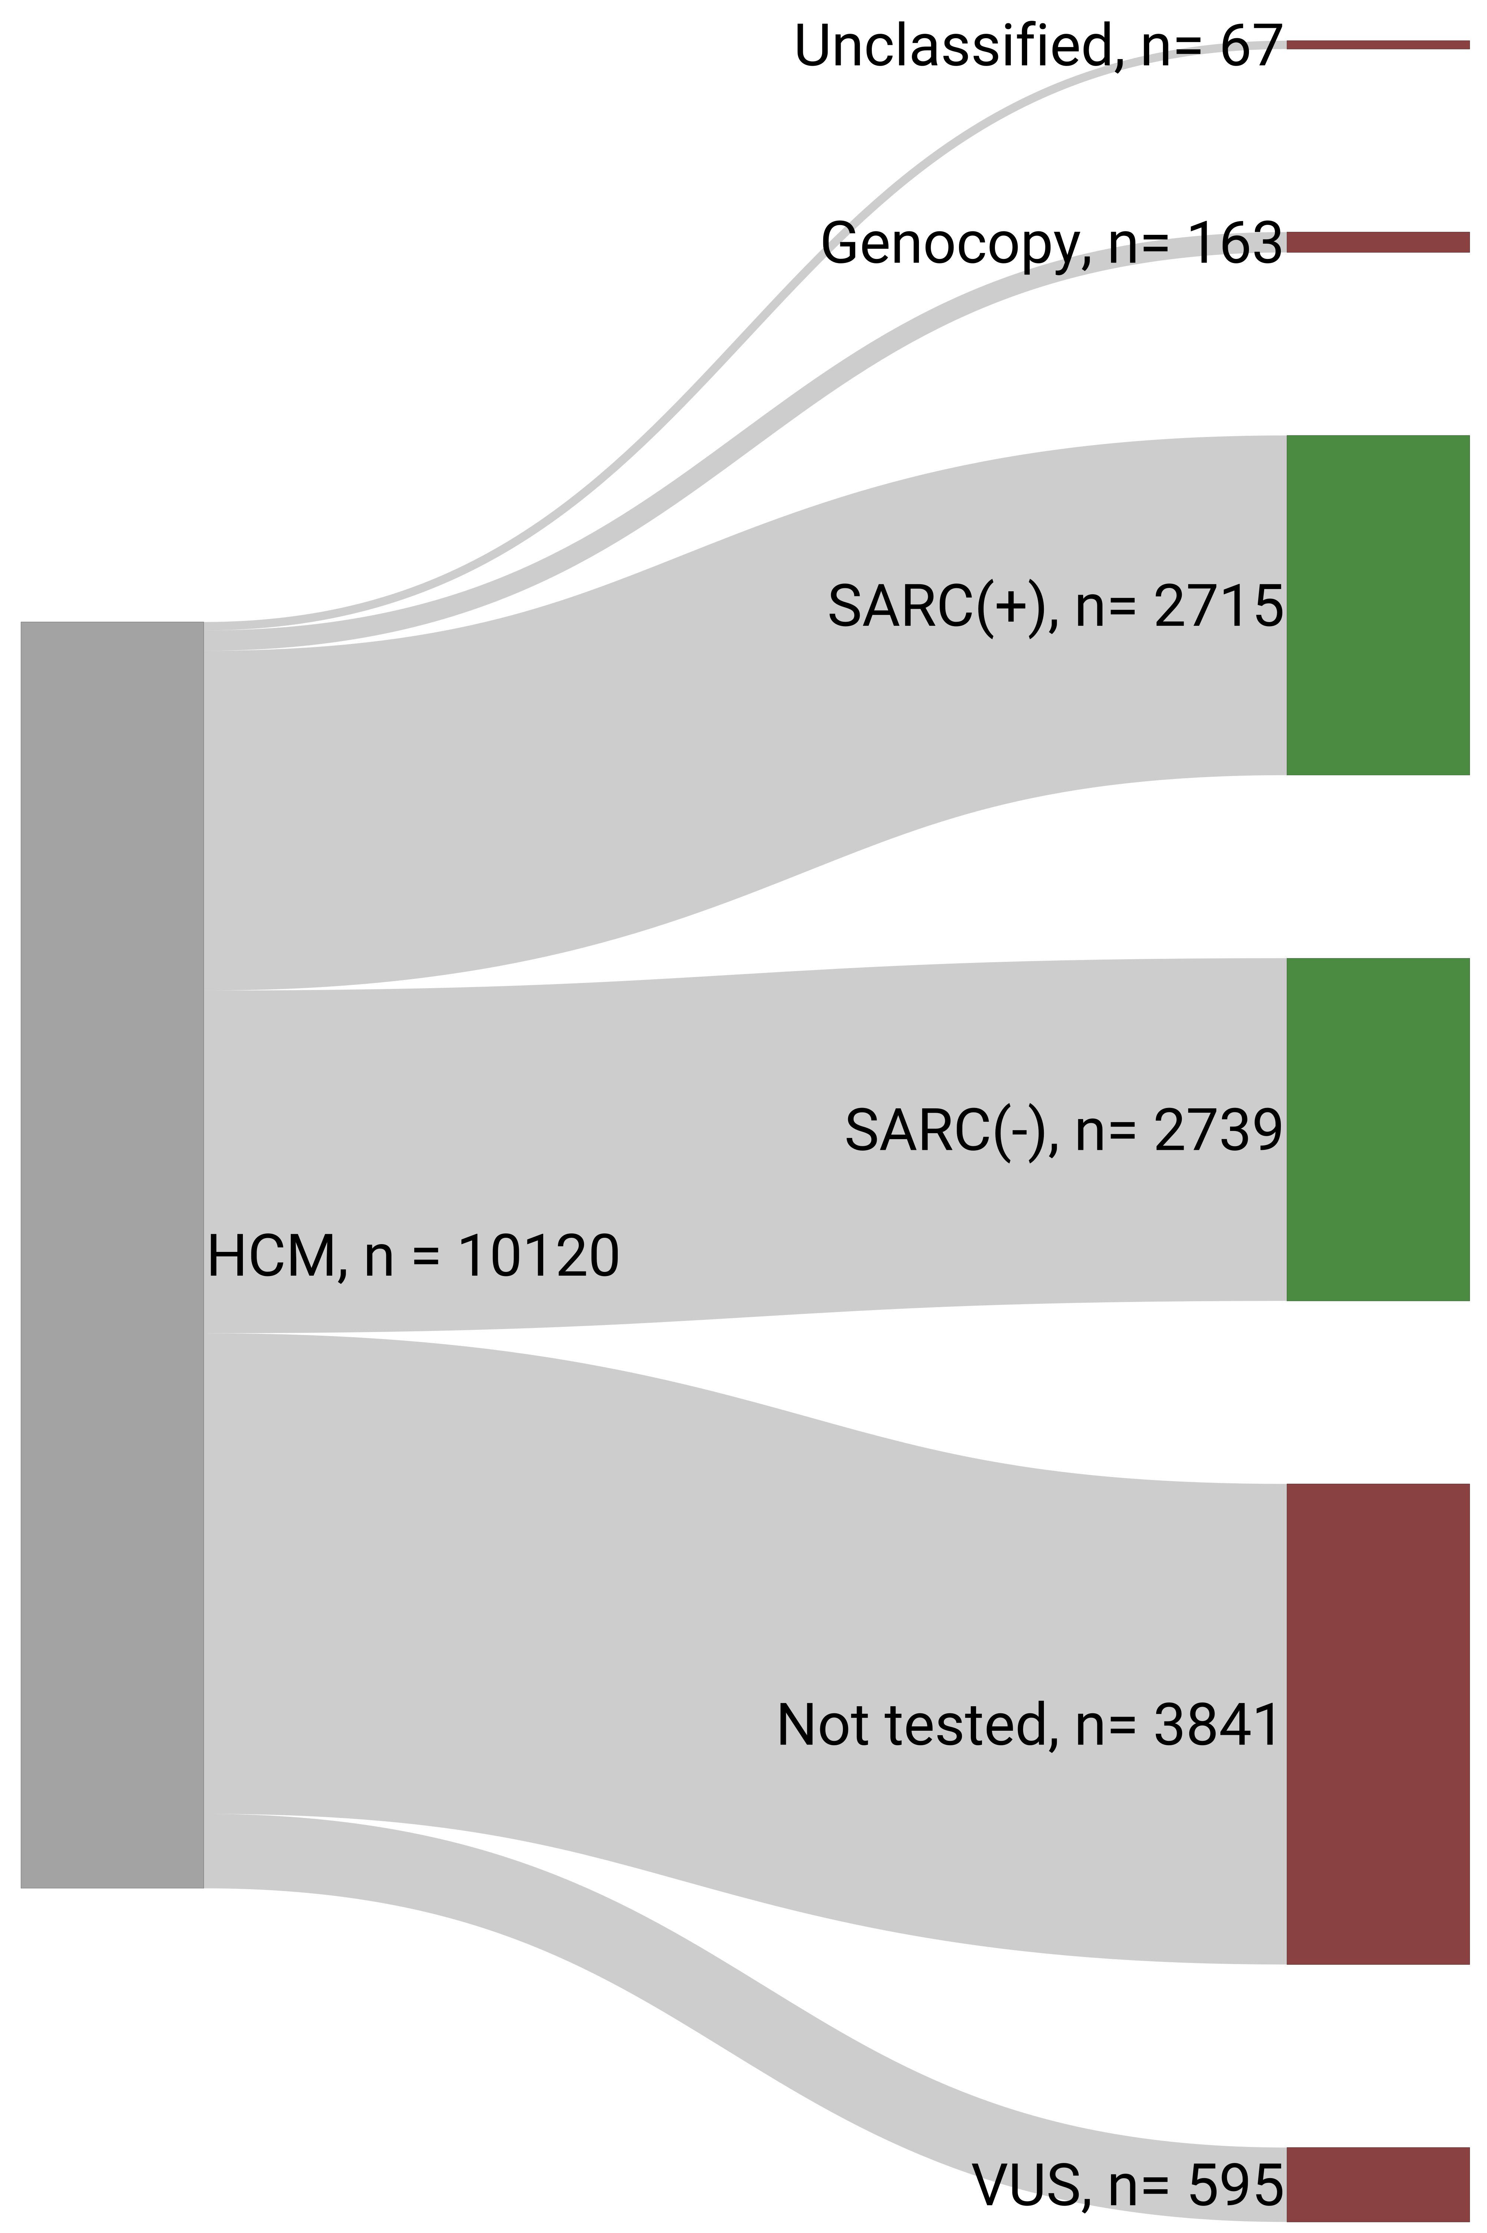
Study Cohort

Slide 6




Study design

Slide 7
Clinical characteristics

Slide 8
Clinical characteristics

Slide 9
LV obstruction

Slide 10
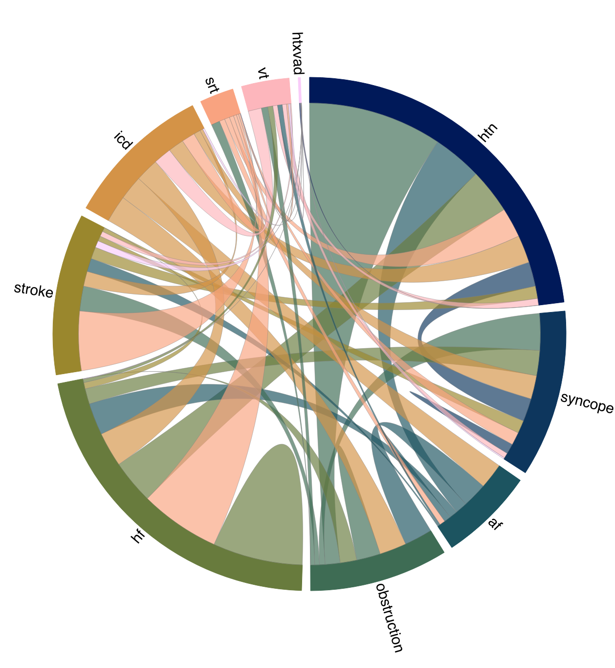
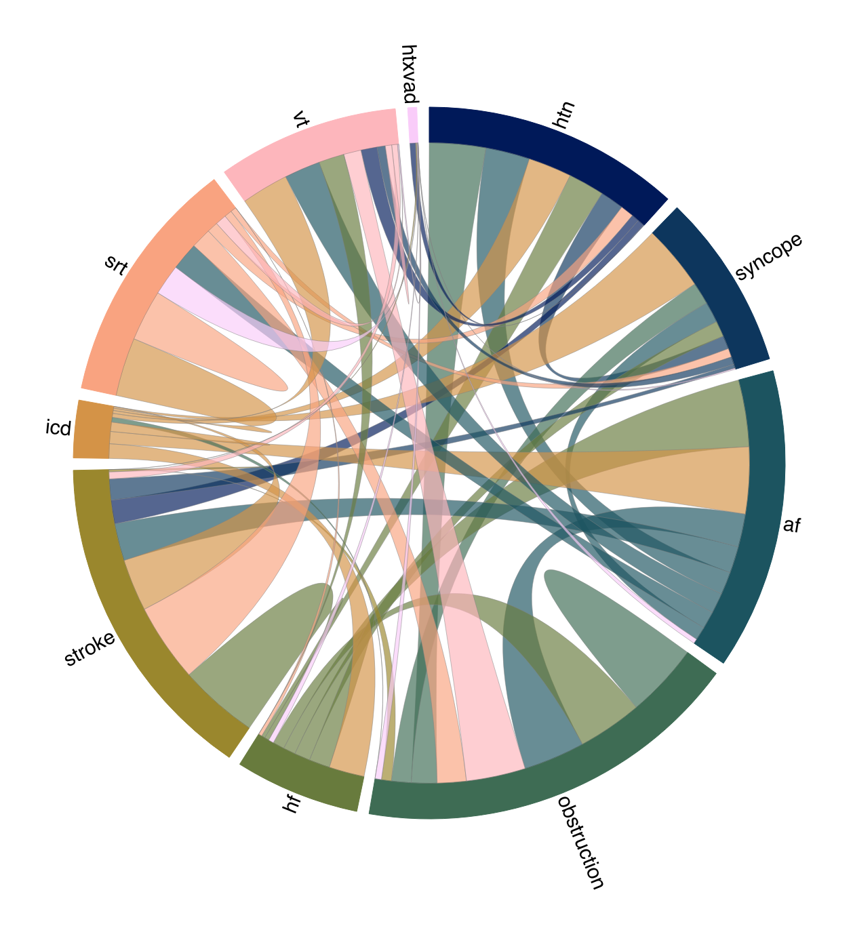

Slide 11
Atrial fibrillation

Slide 12
Ventricular tachycardia

Slide 13
LV systolic dysfunction

Slide 14
Cardiac transplantation

Slide 20
Relative timing of events

Slide 21
Timing of events

Slide 22
Common feature triplets

Slide 23
Common pairs (supp)

Slide 27
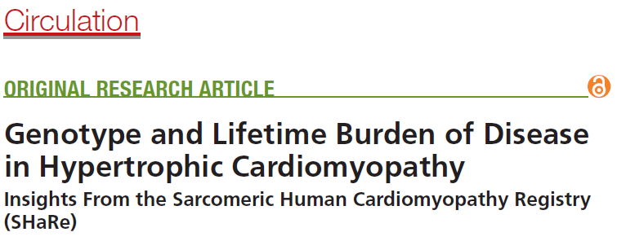
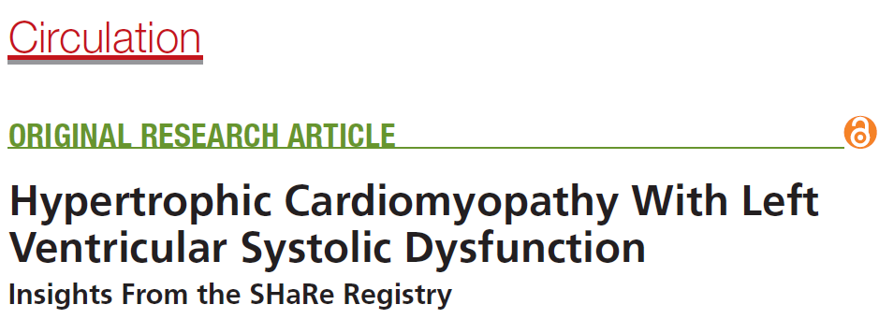
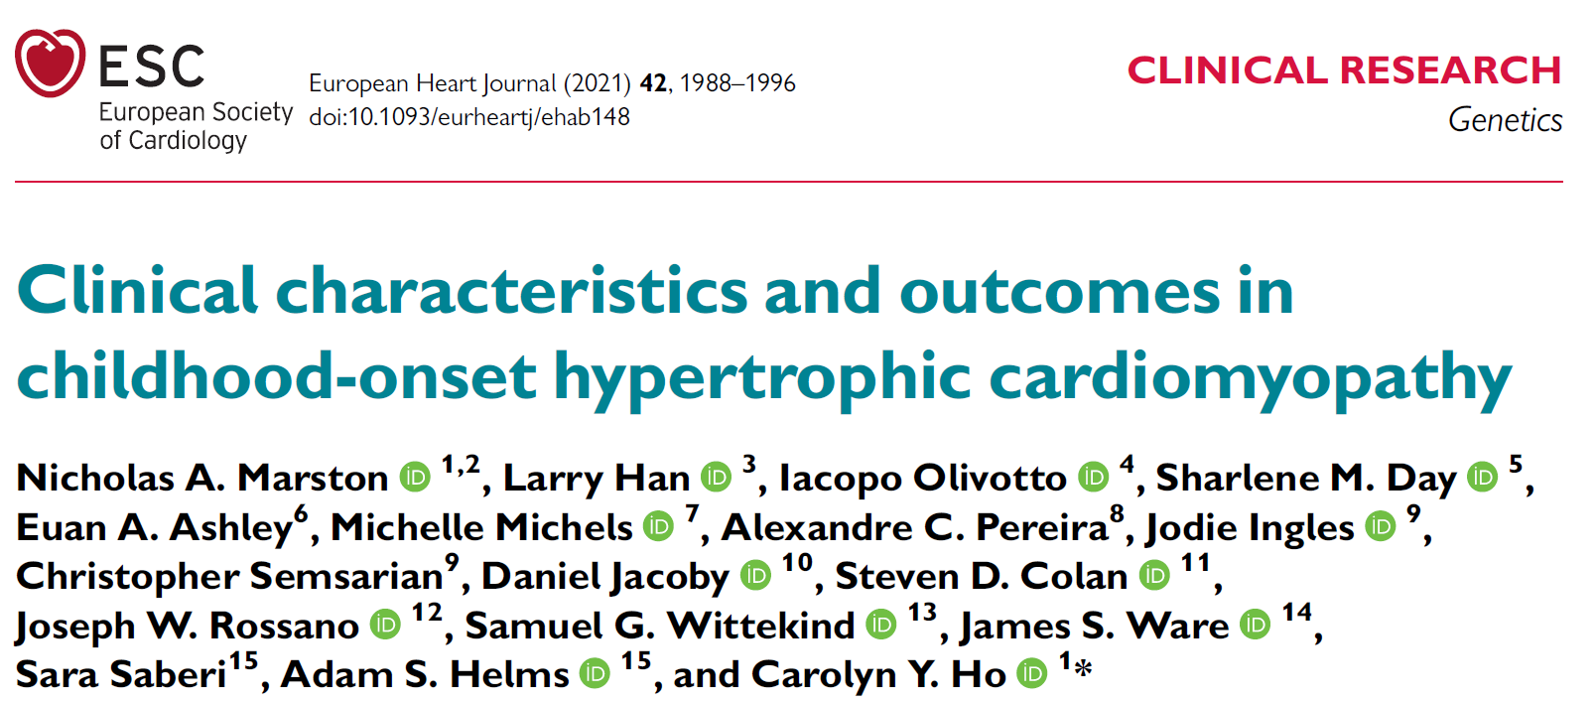
Short background

Slide 28
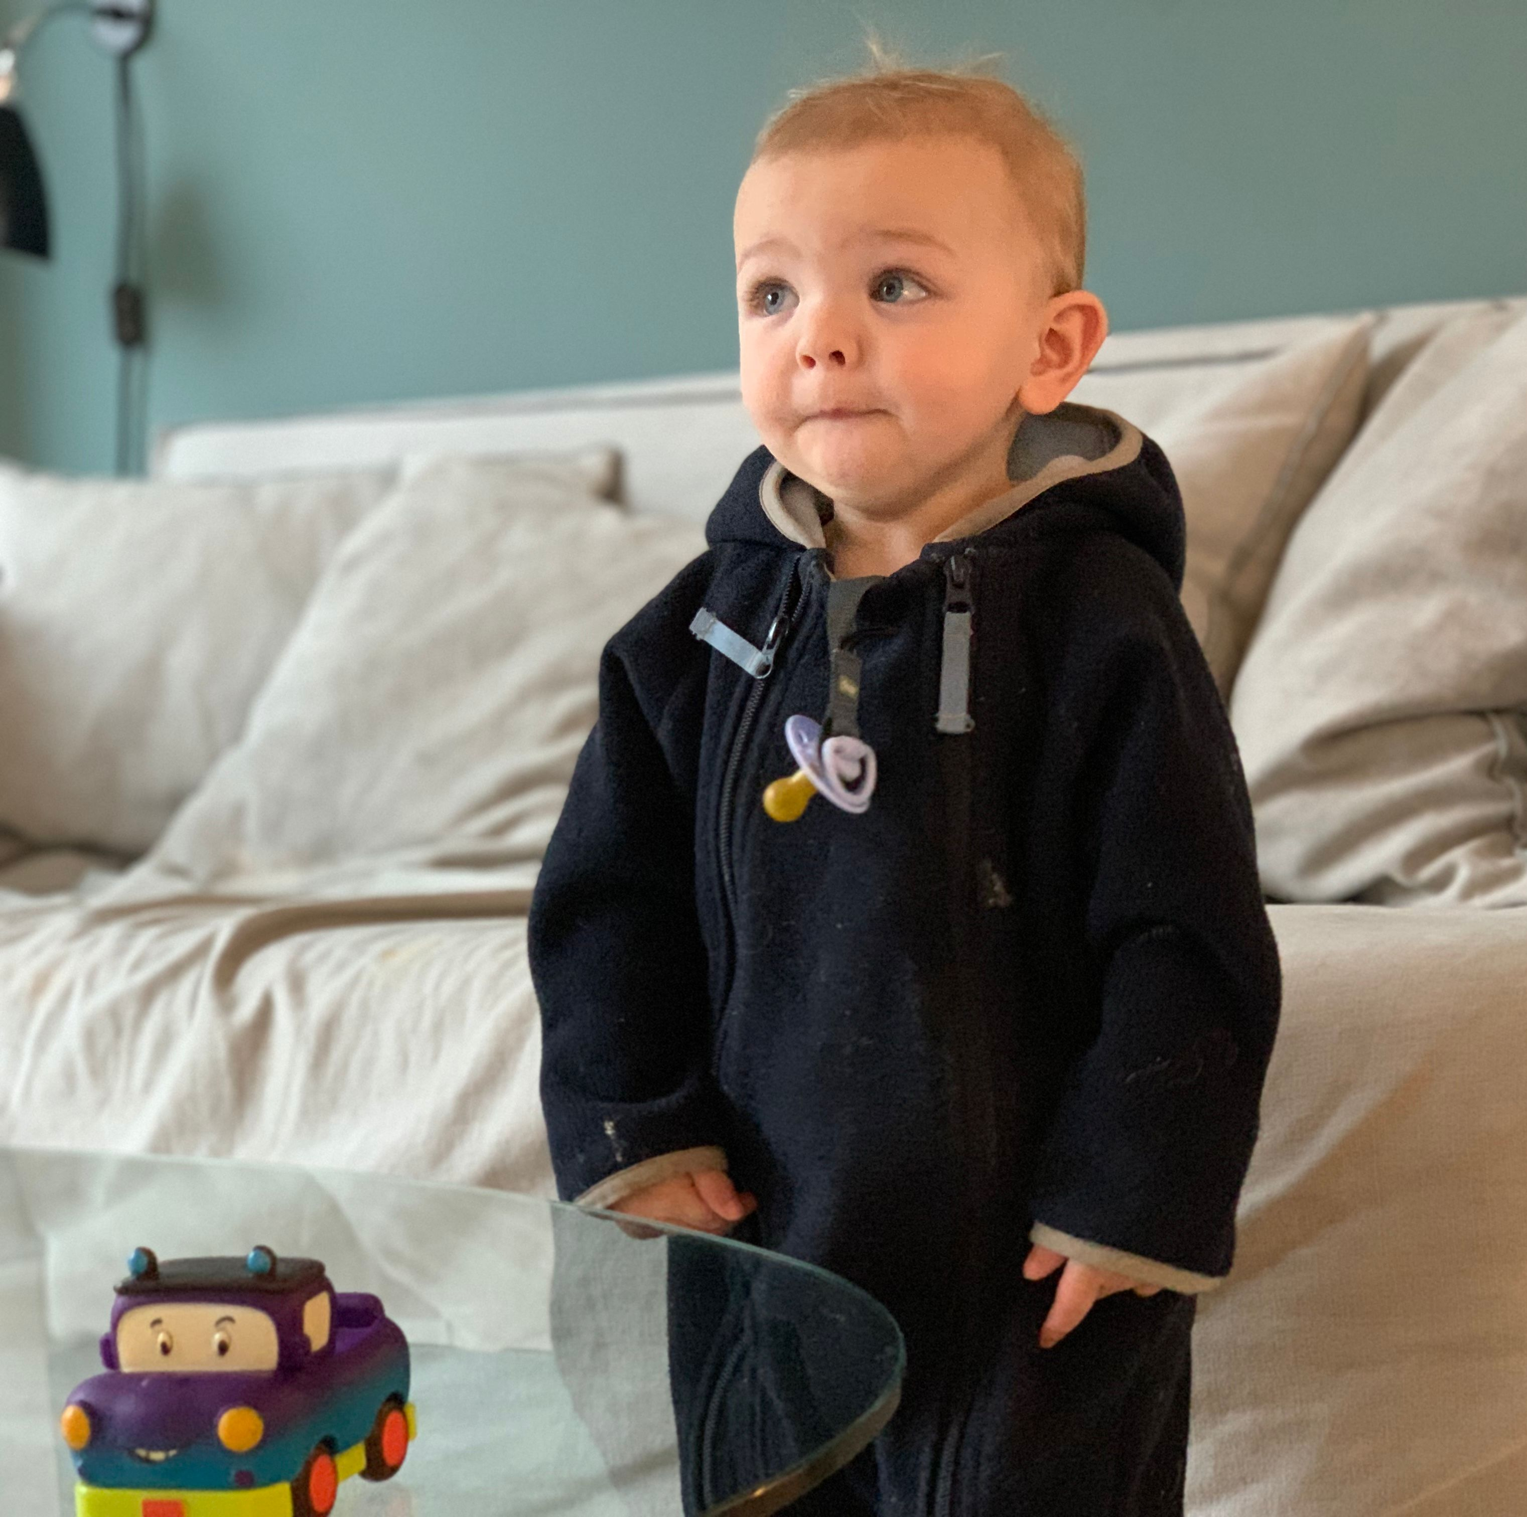
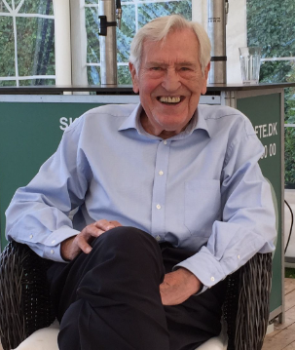
Timing

Slide 29
Agenda
Characteristics of study population
LVSD in childhood HCM
Childhood HCM vs adult-onset HCM
Outcomes
Subgroup in SHaRe
Age distribution
Baseline information

Slide 30
SHaRe
SHaRe dataset updated June 7th 2022
>17.000 subjects
Subgroup with childhood-onset HCM were included
Characteristics of study population

Slide 31
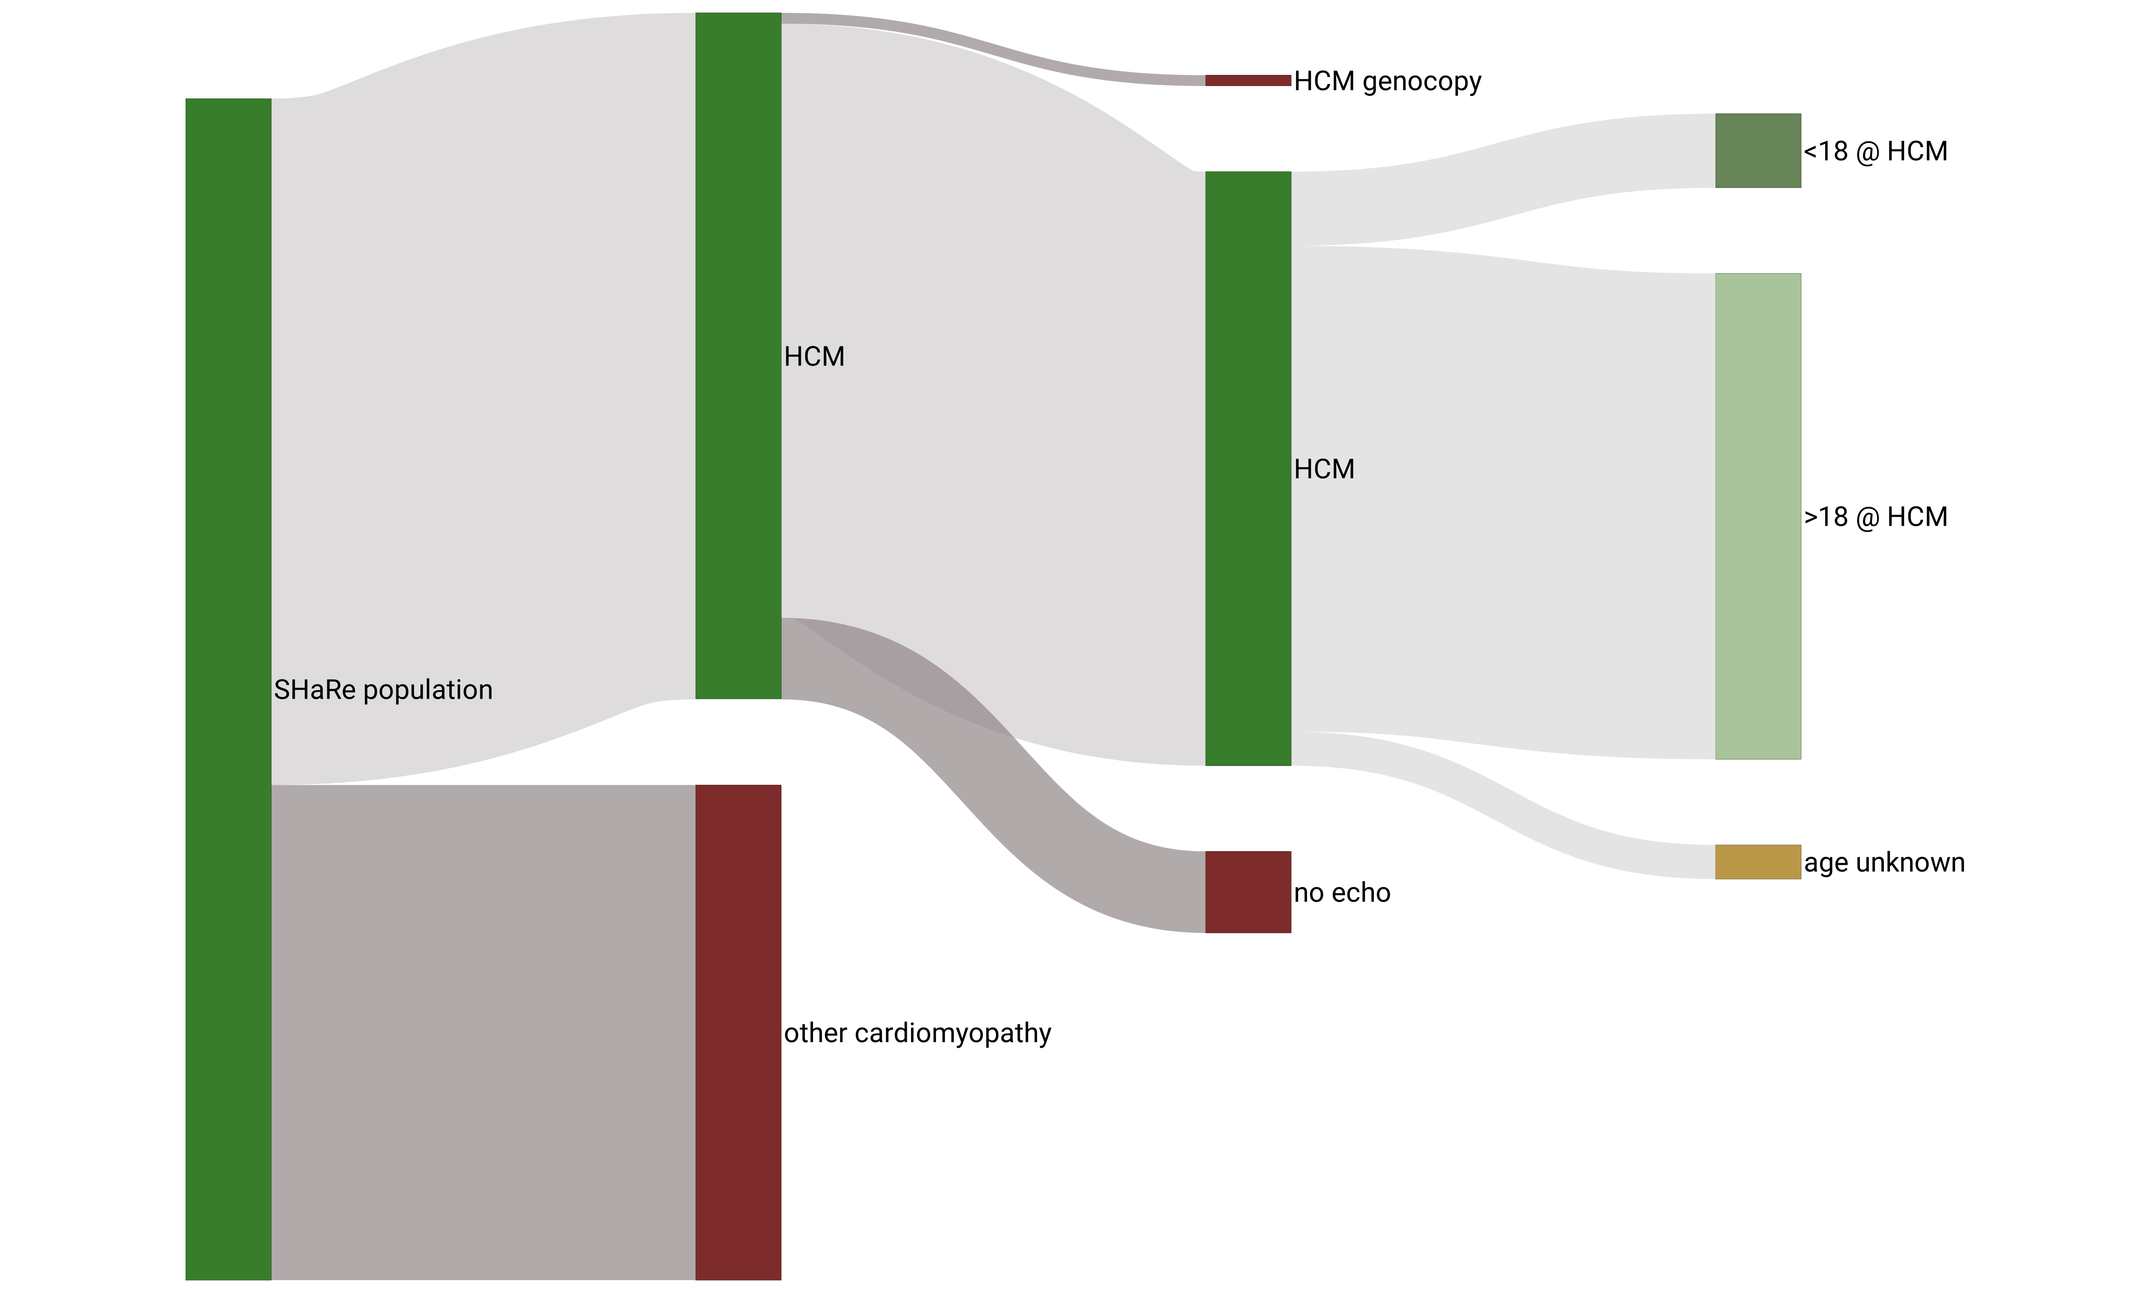
SHaRe - cohort
n= 1.104
n= 10.225
n= 8.848
n= 7.236
n= 17.060
Characteristics of study population

Slide 32
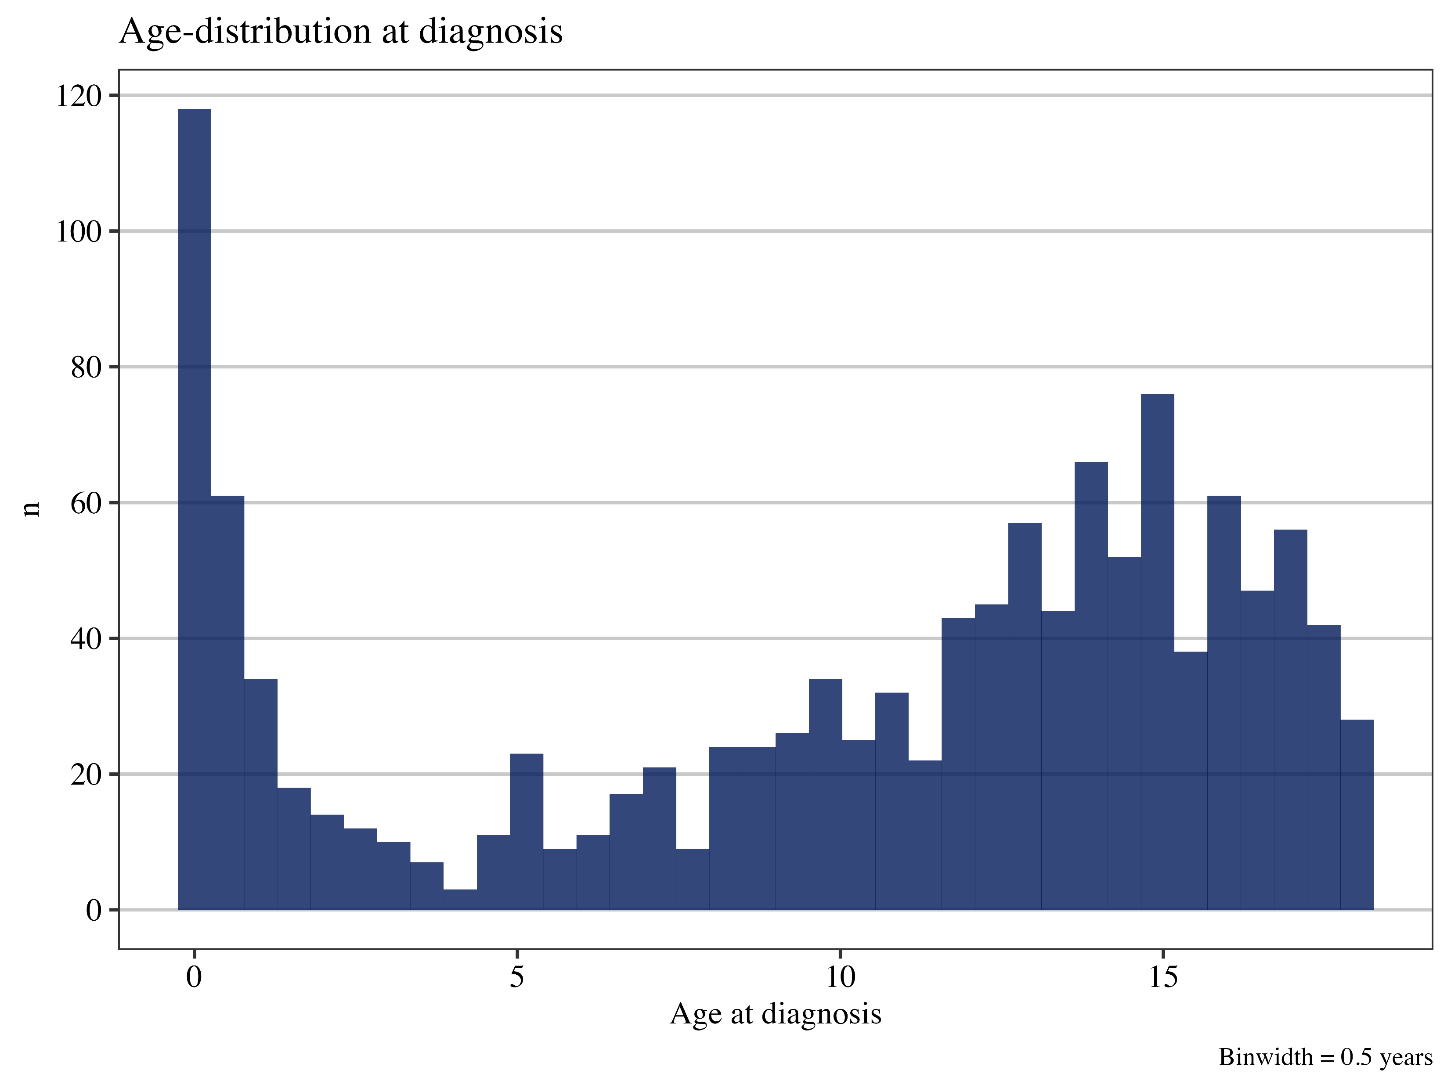
Age at HCM onset
Characteristics of study population

Slide 33
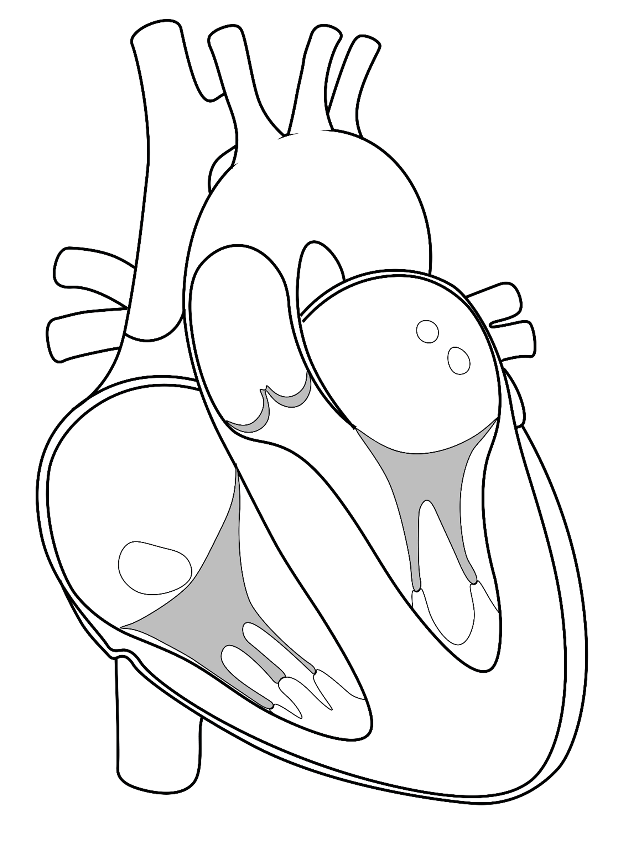
Overall prevalence of 13%
Follow-up
5 years (IQR: 2 to 9.6)
Pediatric-onset HCM
n = 1104 (36% female, 88% probands)
Age at HCM 12.6 (7.3 to 15.3)
LP/P variants in 63%
LVSD at first SHaRe visit in 6.4%
Characteristics of study population
LVSD in childhood HCM

Slide 34
Characteristics of study population
LVSD in childhood HCM
Childhood HCM vs adult-onset HCM
Outcomes
Incidence of LVSD
Factors predicting LVSD
Lowest LVEF in SHaRe

Slide 35
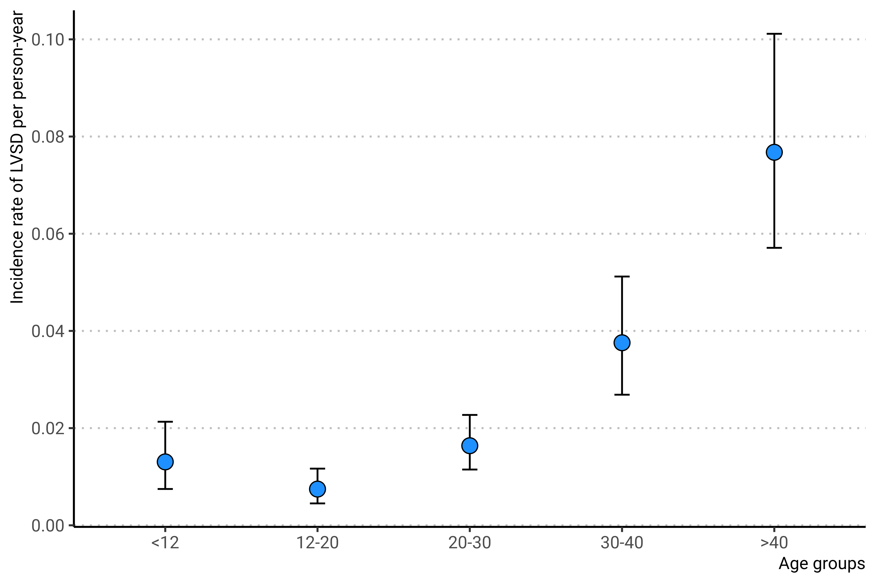
Incidence of LVSD in childhood HCM
Total follow-up:
6966 person-years
Overall incidence
2.1% per person-year
Characteristics of study population
LVSD in childhood HCM

Slide 36
Variables associated with LVSD
LVSD in childhood HCM

Slide 37
Lowest recorded LVEF in SHaRe
LVSD in childhood HCM

Slide 38
Characteristics of study population
LVSD in childhood HCM
Childhood HCM vs adult-onset HCM
Outcomes

Slide 39
End-stage HCM
Associated with cardiac transplantation, VAD implantation and death
What are the rates of these HF outcomes?
Does the timing of LVSD have an influence on these outcomes?
Other important prognostic factors?
Rate of the composite outcome according to age-group and presence of LVSD

Slide 40
Prognostic markers of HF outcomes in childhood HCM-LVSD
Outcomes

Slide 41
Age specific incidence of the composite outcome
Composite HF in subjects with vs without LVSD
Composite HF in subjects with childhood- vs adult-onset
Composite ventricular arrhythmia in subjects with vs without LVSD
Composite ventricular arrhythmia in subjects with childhood- vs adult-onset

Slide 42
Age specific incidence of HF outcomes in HCM regardless of timing
Outcomes

Slide 43
Age specific incidence of HF outcomes according to age at diagnosis
Outcomes

Slide 44
Conclusion and perspective Summary
LVSD in childhood
Crude incidence rate of LVSD of 2.1% per person-year in childhood-HCM (1.5% in adult-onset)
LVSD was predicted by young age at HCM (less than 12), sex (higher in males), carrying thick filament variants or multiple LP/P, and lower baseline LVEF.
Higher LVSD incidence in children, most evident in period immediately following HCM-diagnosis, and in more advanced age-groups.
Outcomes
High incidence of composite HF outcomes in childhood-HCM-LVSD.
Composite HF occure at higher rate in females with LVSD and in subjects with severe LV dysfunction.
Events occur at high incidence in young children, suggesting a special endotype in these subjects.
Age-specific rates highlight that early phenotypic conversion signifies higher event-rates throughout life.

Slide 45
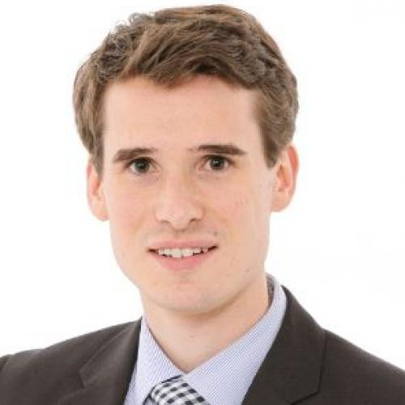
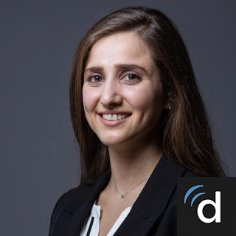
Thank you
Carolyn Ho
Thomas Roston
Sarah Abou Alaiwi
Corine Sinnette
Richard Cope
All SHaRe investigators
Mail: Christoffer.rasmus.vissing@regionh.dk
Twitter: @ulvedreng
Github: christoffervi

